Slide 1
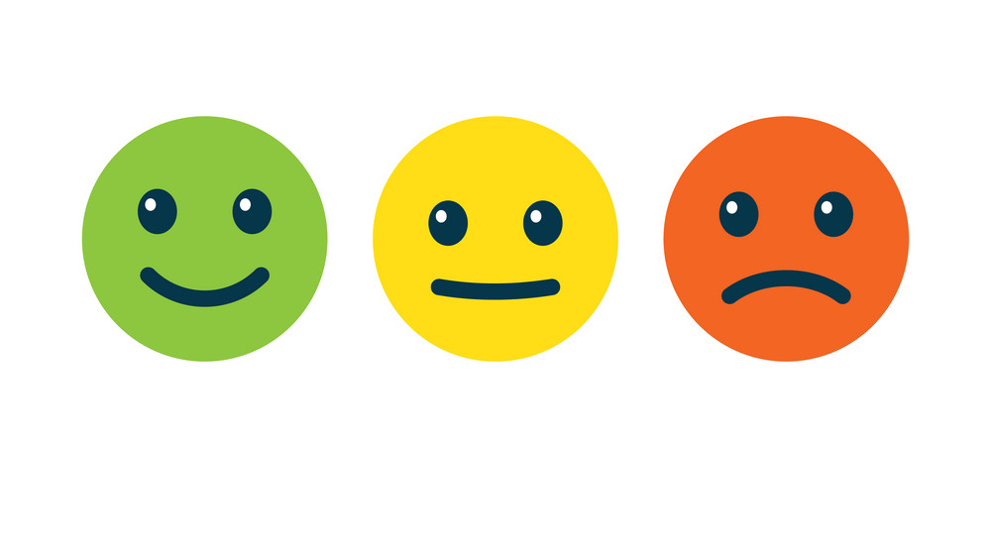

Tweet Sentiment Classification
Bethel Ikejiofor & Valerie Huston

Slide 2
About Me: Bethel Ikejiofor
BS in Applied Math from Rensselaer Polytechnic Institute
Worked as a Data Analyst at Bloomberg LP & JPMorgan Chase
Incoming Associate Data Engineer at phData

Slide 3
About Me: Valerie Huston

Slide 4

Background
The objective of this project is to classify the overall sentiment of a tweet's context as neutral, negative, or positive using NLP classifiers. To complete, this project, we are given a dataset of 27,481 tweets, where 22,464 of those tweets were captured as having either a neutral, negative, or positive sentiment. Our goal is to use this training data of ~27.5k tweets to predict the sentiment of the 3,534 tweets in our testing data set.

Slide 5
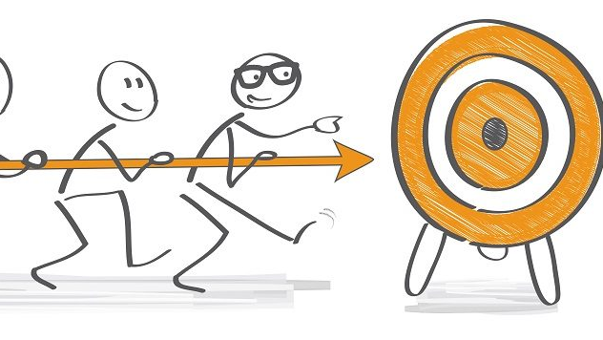
Objective
Given a testing and training set, we ran NLP on a series of tweets to categorize their sentiments as bad, good, or neutral. We then use the testing dataset to see how efficient the NLP classifier is from there and tune the algorithm and compared different sentiment analysis models.

Slide 6
Questions
What words contribute to how a tweet's sentiment is classified?
Given a testing set, where is a tweet likely to fall on a sentiment scale?
How does classification precision change with different classification models implemented?

Slide 7
Classification Models

Slide 8
“p-hacking” Model
What’s p-hacking?
Manipulating data analysis to produce a favorable result as being statistically significant
Why is this the p-hacking model?
Within the analysis, depending on how we decided to order the sentiments in the end classification, results would be skewed towards whatever sentiment came first.
E.g.: If we coded our classifications as “negative, positive, neutral” instead of “positive, negative, neutral” - the first model would produce higher accuracy for negative classification while the second model would produce higher accuracy for positive classification.

Slide 9
“p-hacking” Model Production
Categorize positive, negative, or neutral sentiments as distinct sets dependent upon training set’s “selected_text” column and associated dataset.
Using words in testing dataset, assign probability of text’s sentiment using sets described above, assign text to highest probability sentiment, and assess precision.

Slide 10
“p-hacking” Example
Training Dataset
Neutral words = “I’d”, “have”, “responded”, “if”, “I”, “were”, “going”
T
selected_text | Sentiment
I’d have responded, if I were going | neutral

Slide 11
Afinn Model
Afinn contains 3300+ words with a polarity score associated for each word being used in a sentiment analysis.
There is a built-in function for the Afinn lexicon where scores are assigned to the text:
If score > 0, then sentiment is positive
If score < 0, then sentiment is negative
Else, the sentiment is neutral.

Slide 12
Afinn Example
It’s a beautiful day.
Polarity: 0.85
The move is badly directed.
Polarity: -0.69
The weather today is pleasant
Polarity: 0.73
Positive
Negative
Positive

Slide 13
Results from Afinn Model
84% accuracy with positive sentiment tweets
62% accuracy with negative sentiment tweets
54% accuracy with neutral sentiment tweets
65% overall accuracy for sentiment classification

Slide 14
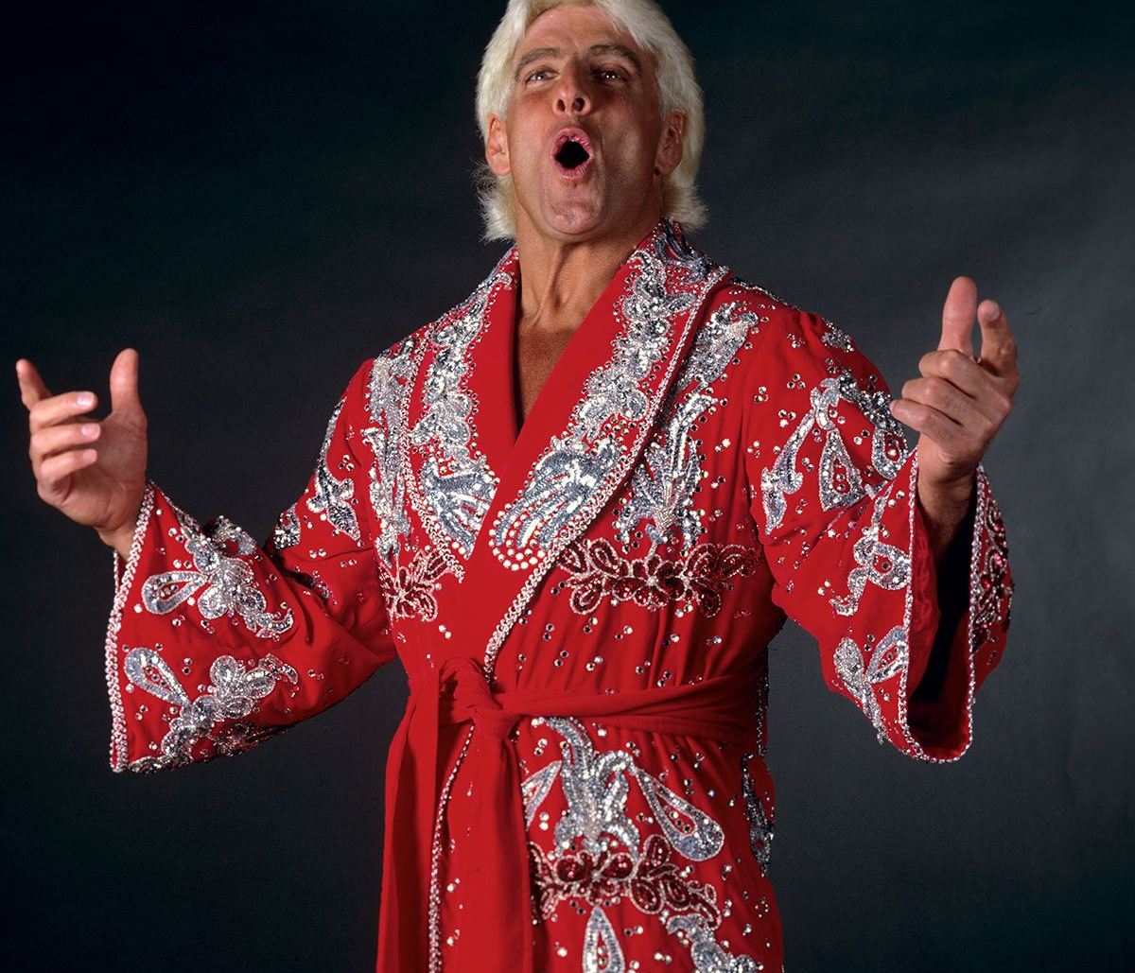
Flair Model
Flair utilizes a pre-trained model to detect positive or negative comments and print a number in brackets behind the label which is a prediction confidence.
It contains a powerful library which allows users to use and combine different word and document embeddings. Based on the corpus, it could analyze and tell the attitudes of the speakers. Comparing with other NLP packages, flair’s sentiment classifier is based on a character-level LSTM neural network which takes sequences of letters and words into account when predicting.

Slide 15
Flair Model Results
99.97% accuracy for negative sentiment
0% accuracy overall
99.73% accuracy for positive sentiment

Slide 16

TextBlob Model
TextBlob is a sentiment classifier that uses a movie reviews dataset where reviews are labeled positive or negative.
Positive and negative features are extracted from each positive and negative reviews.
This becomes the foundation of the training data, which consists of labeled positive and negative features. The data is trained on a Naïve Bayes Classifier
TextBlob then assigns the polarity of a tweet between -1 and 1.
If polarity > 0, then positive
If polarity = 0, then neutral
Else, negative

Slide 17
TextBlob Example

Slide 18
TextBlob Model Results
78.06% accuracy for positive sentiment
49.05% accuracy for negative sentiment
51.12% accuracy for neutral sentiment
58.94% accuracy overall

Slide 19
VADER Model
Valence Aware Dictionary and sEntiment Reasoner
A lexicon and rule-based sentiment analysis tool specifically designed to detect sentiment expressed in social media
Uses a list of lexical features, like words which are labeled as being positive or negative
VADER tells a positivity and negativity score but also tells how positive or negative a sentiment is.

Slide 20

VADER Example
Sentence: “I am very sad today.”
VADER Probability:
Sentence was rated as 50.8% Negative
Sentence was rated as 49.2% Neutral
Sentence was rated as 0.0% Positive.
VADER says “Sentence Overall Rated as Negative”

Slide 21
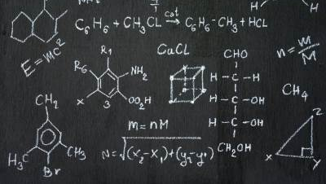
How VADER Works
Generates a compound score which is the sum of all the normalized lexicon ratings between -1(most extreme negative) and +1(most extreme positive).
If compound score >= 0.05, then positive sentiment
If compound score <= -0.05, then negative sentiment.
If compound score between -0.05 and 0.05, then neutral sentiment.

Slide 22
VADER Model Results
88.49% accuracy for positive sentiment
64.83% accuracy for negative sentiment
46.99% accuracy for neutral sentiment
Overall accuracy for 64.99% sentiments across all sentiments.

Slide 23
Naïve Bayes Classifier Model
Bayes’ Theorem: The probability of an event A given that an event B has occurred is the probability of event B given that A has occurred multiplied by the probability of event A.
Bayes’ theorem is the basis of Naïve Bayes, which then acts as a probabilistic classifier.

Slide 24
Naïve Bayes Results
 | Precision
Negative | 75%
Neutral | 54 %
Positive | 77%

Slide 25
Images

Slide 26
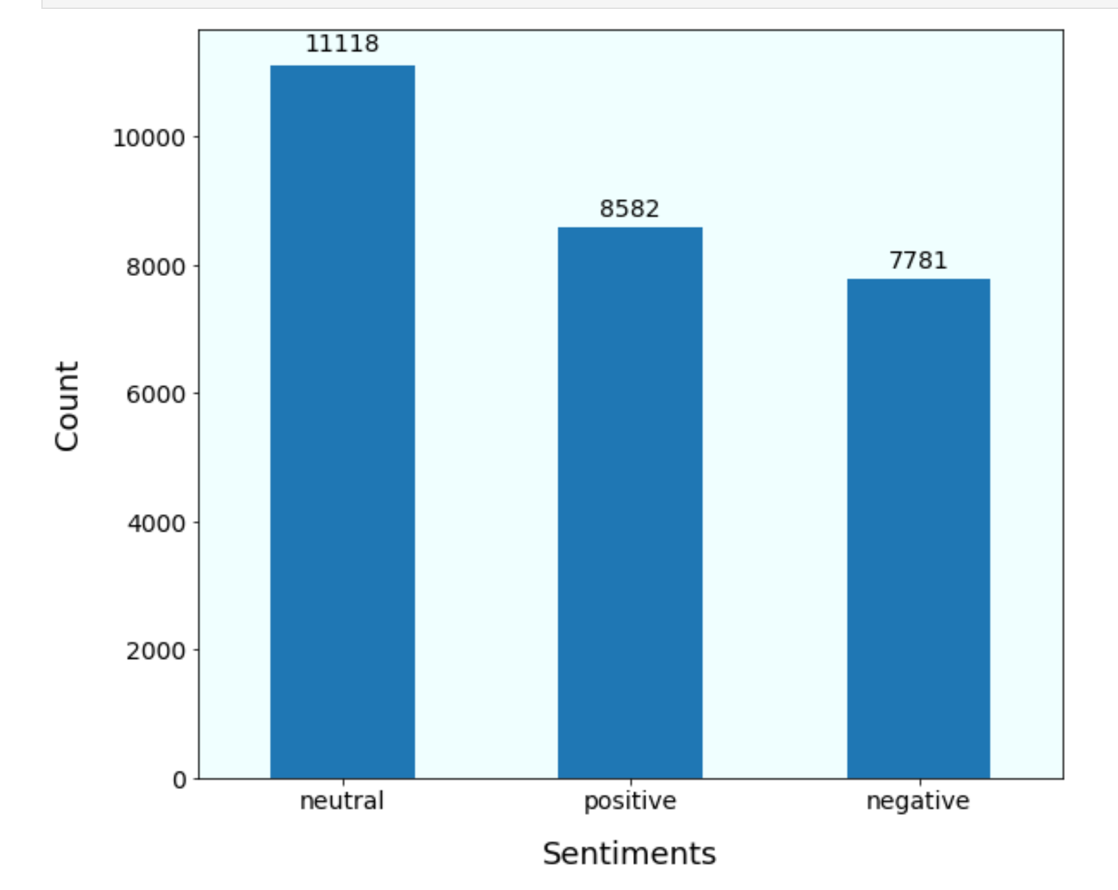
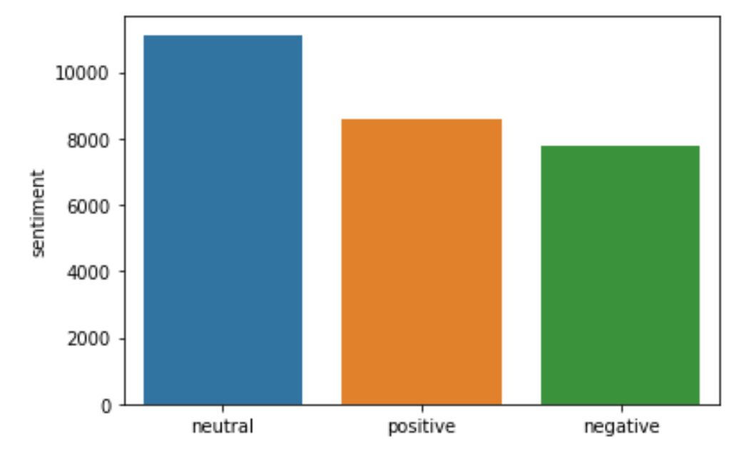

Slide 27
